Slide 1
OTHELLO
Why is the play even more relevant today?

Slide 2
Othello on Broadway 2025
This year’s celebrity driven Broadway revival of Shakespeare’s Othello commanded the highest ever ticket prices for a non-musical. $900.
The key themes of jealousy, deception and racial prejudice dominate; but seen in today’s charged world, the intersection of politics, ambition and disinformation resonate more loudly than ever. Why is Othello so easily manipulated? Why does Iago go to such extremes to poison the mind of the Moor of Venice?
Denzel Washington and Jake Gyllenhal starred. Audiences applauded but critics panned. “Sometime in the future”, in modern military dress
Othello in Shakespeare’s body of work. 1604. Followed Hamlet in 1600. Shakespeare’s only son, Hamnet, died age 11, 1596.
Settings – Venice, Cyprus, Ottoman Turks threats to Venetian dominance
Origin story drawn from works of Italian writer Cinthio in 1565.

Slide 3
Backstory and Plot
Act I iii tells us that Brabantio respected Othello and entertained him in Brabantio’s home
Desdemona enamored of Othello from his war stories
Many 17^{th-18th} century paintings
Plot accelerates rapidly, Shakespeare gives no parallel plot/ comic relief
Othello depicted as man of integrity, power, charisma, reputation
Othello is a respected black man until he enters into a mixed-race marriage
Settings in Venice and then Cyprus. First scene below Brabantio’s house
Second scene – introduces Othello’s soldiers - all mercenaries from other cities
When Brabantio tries to have Duke annul marriage, Othello and Desdemona sway opinion. And then they are sent to Cyprus to defeat the Turks
Iago seizes on opportunities to improvise ways to poison Othello with lies about Desdemona
Those lies metastasize and drive Othello mad with jealousy – leads him to murder

Slide 4
Is Othello Black or a Moor??
In Shakespeare's time, "Moor" - broad term for dark-skinned people, often Muslim, from North Africa or the Iberian Peninsula,
The Moors represented a cultural "other" for white Europeans
In Othello, this identity signifies Othello's outsider status, racial difference.
Moors were people of mixed Berber and African descent.
Othello and his soldiers are sent to Cyprus to fend off an attack by the Ottoman Turks.
The Ottoman–Venetian wars were a series of conflicts between the Ottoman Empire and the Republic of Venice that started in 1396 and lasted until 1718
In Shakespeare’s time Othello was depicted as a turban wearing Moor of darker skin.
Over time, the portrayal of Othello as a black man brought a more feverish racism to the surface

Slide 5
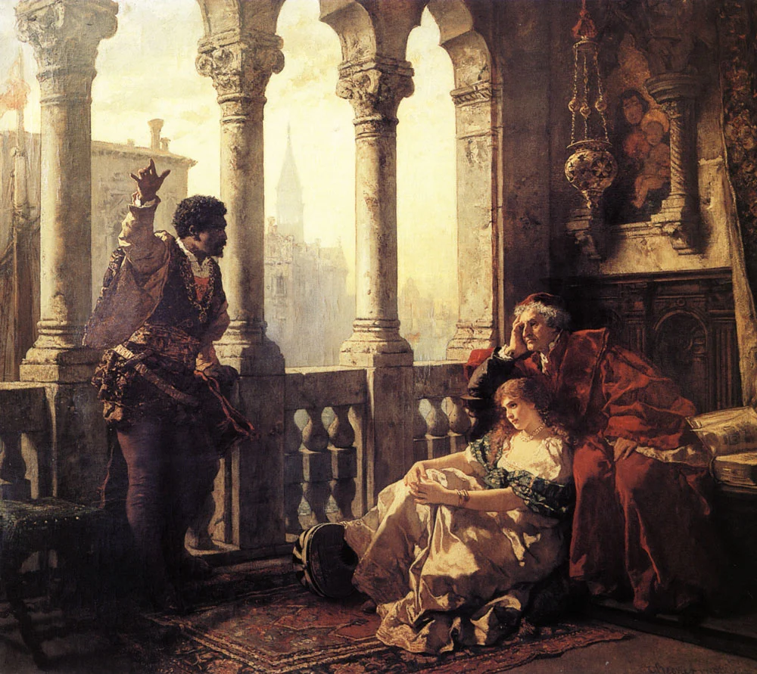

Slide 6
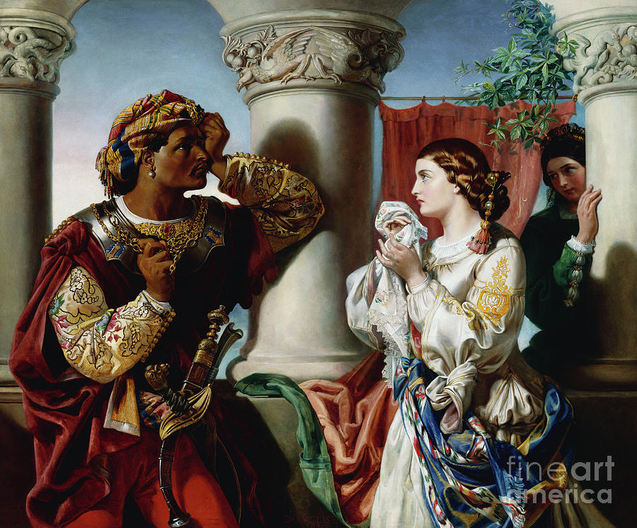

Slide 7
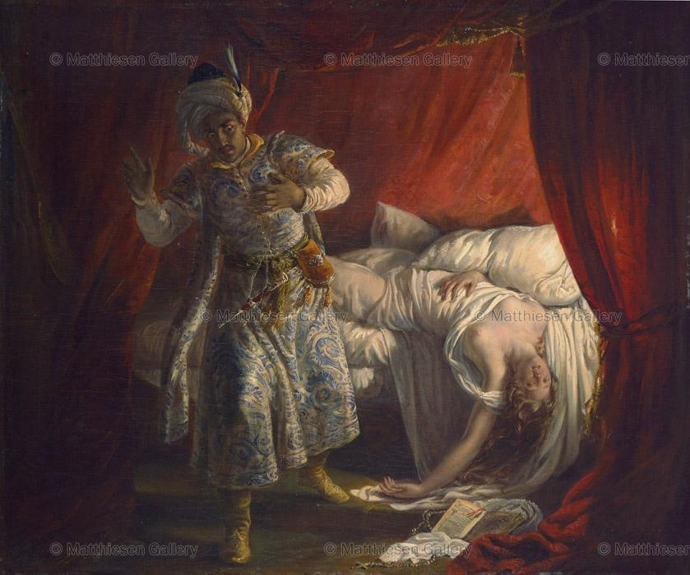

Slide 8
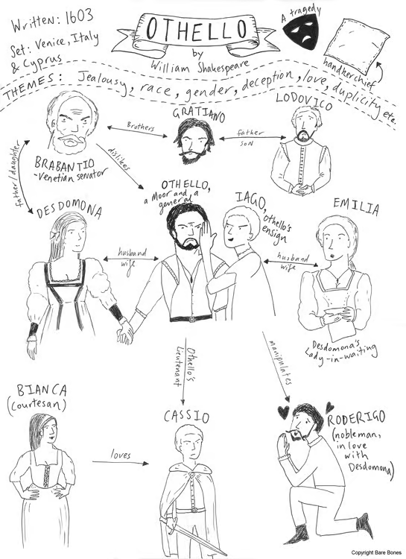

Slide 9
Theatre Production History
From ancient Greece through Shakespeare’s time, all female roles were played by young men.
London stages full of young men trained in gestures of femininity.
Edward/Ned Kynaston the “most beautiful woman on the English stage,” famous for portrayal of Desdemona.
English Restoration – King Charles II - 1660 – decreed no more men playing the girls’ parts – allowing women to play female roles.
Stage Beauty - English play made into film
Actors playing Othello were always white men in blackface – as late as 1964, Laurence Olivier, Anthony Hopkins played in 1981.
First black actors to play the role of Othello: Ira Aldridge – played Othello in London 1850s; Paul Robeson in US 1943.
James Earl Jones, Laurence Fishburne and Denzel Washington

Slide 10
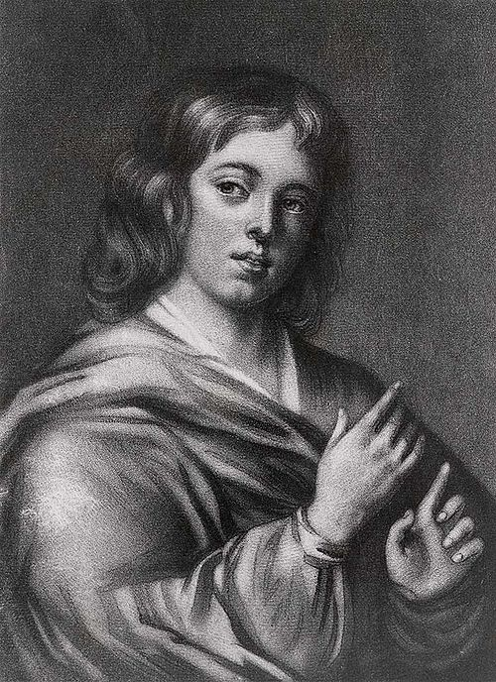
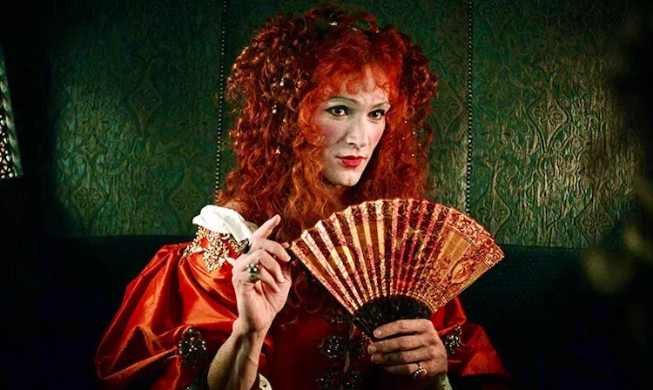
Ned Kynaston as Desdemona / Stage Beauty

Slide 11
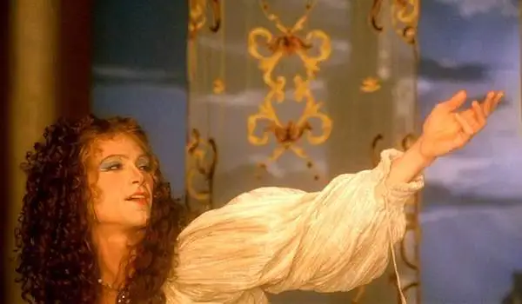
Kynaston (Crudup) as Desdemona – Stage Beauty

Slide 12
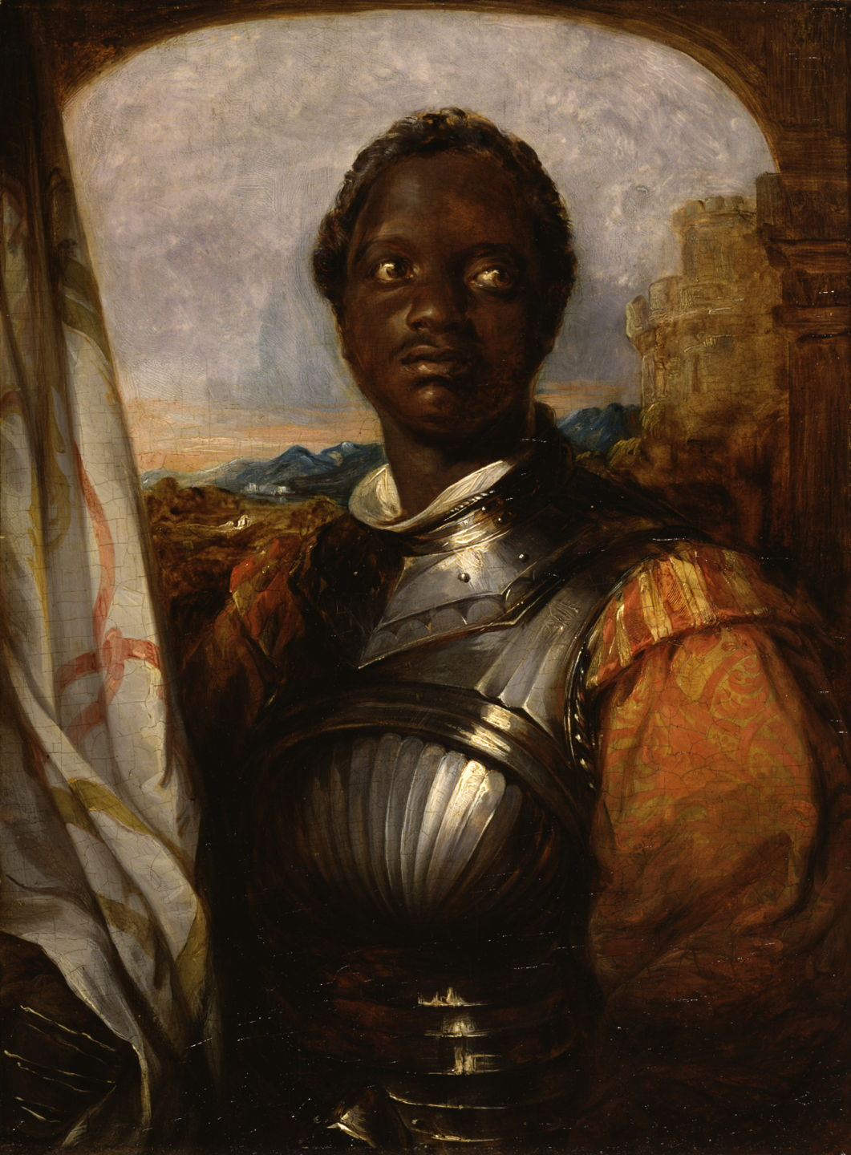
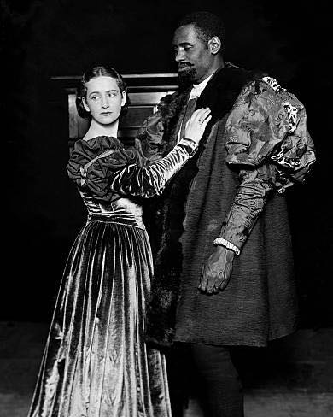
Ira Aldridge, Paul Robeson

Slide 13
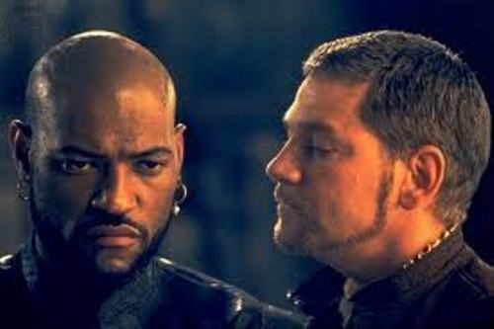
Laurence Fishburne and Kenneth Branagh

Slide 14
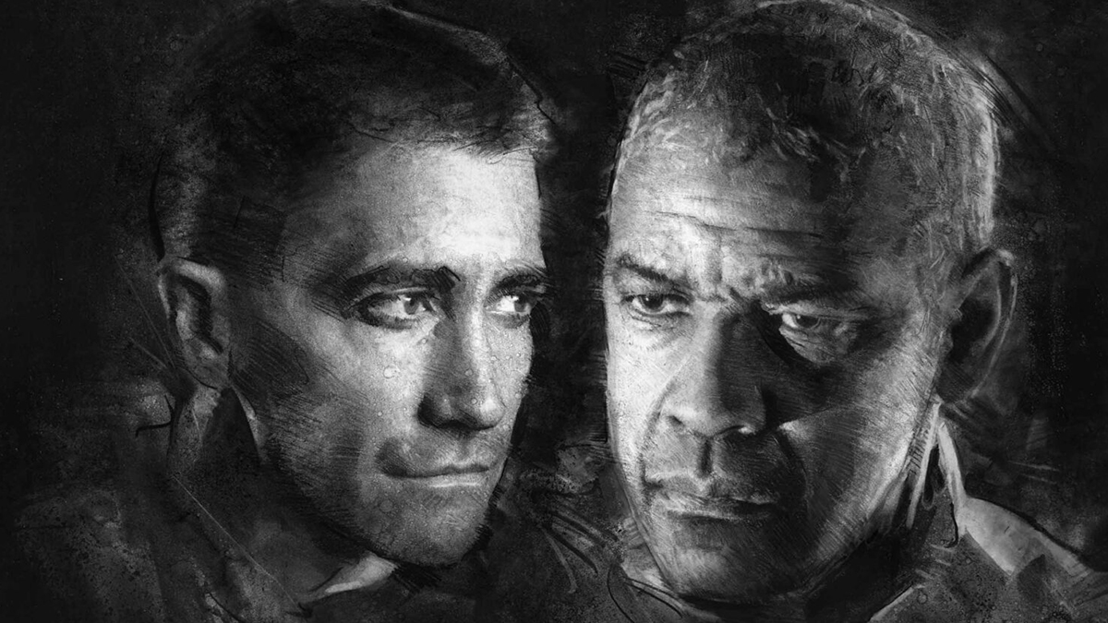
Jake Gyllenhall and Denzel Washington

Slide 15
The Language of Othello
Shakespeare delights in inventing what we call tropes or memes – starting early in the play
Iago: “I will wear my heart upon my sleeve, for daws to peck at; I am not what I am”
Iago: “Even now….an old black ram is tupping your white ewe.”
Iago: “O, beware my lord, of jealousy: It is the green-eyed monster which doth mock the meat it feeds on.”
Iago: “…your daughter and the Moor are (now) making the beast with two backs.”
Othello: Refers to Iago as “Honest, honest Iago.” Some 45 times
Duke to Brabantio: “Your son-in-law is far more fair than black.”
Othello: “O curse of marriage That we can call these delicate creatures ours, And not their appetites! I had rather be a toad, And live upon the vapors of a dungeon, Than keep a corner in the thing I love For others’ uses.”
Othello: “Put out the light; Then put out the light.”

Slide 16
Othello’s Psyche
Othello is a great military commander – he knows little more than war – he can’t visualize what he doesn’t know. He sees himself as larger than life.
He has trusted Iago; but when another lieutenant – Cassio – impresses Othello in battle, he promotes Cassio over Iago – lighting the match of Iago’s jealousy
Othello Syndrome – psychiatric diagnoses of unbridled jealousy that leads to violence
Othello frequently refers to himself in the 3rd person –
Othello trusts – yet is persuaded to doubt. He is too tied up in his sense of worth – his reputation – that the mere thought of being cuckolded by his wife drives him into an epileptic seizure
Was the marriage of Othello and Desdemona ever consummated?
Act 3 begins the inevitable acceleration of Iago’s lies and now Othello is his willing puppet
Once Othello has killed her, he makes his tragic excuse: “Then you must speak Of one that loved not wisely, but too well.”

Slide 17
Iago’s Psyche
Iago’s age – 28 – Othello is generally thought to be late 30s/early 40s
Iago’s jealousy of Othello – “I hate the Moor.” Propels Iago to take increasing risks – planting lies, manipulating characters like a malicious puppeteer.
Iago is the Great Improviser. Taking advantage of openings as they present themselves. – Roderigo’s obsession with Desdemona, the dropped handkerchief.
Iago initially driven by jealousy – of Cassio – who was promoted over him – a younger rival for Othello’s love – SO RELATABLE.
Iago becomes ever more confident in his diabolic artistry – prodding Othello and others to calamity
Iago perfects the art of DISINFORMATION, DISORIENTATION, AND DERANGEMENT
We only dream of revenge – Iago embodies it. Iago is a “sublimely sadistic comic poet,” [Harold Bloom]. He operates in a void – with no moral compass.

Slide 18
Key Turning Points
Elements of Ambition and Reputation are key to the first 2 acts.
Act 2 Scene 3 – Iago gets Cassio drunk. Then goads him into a fight with Roderigo – who is obsessed with Desdemona and jealous of Othello.
Othello witnesses brawl and banishes Cassio – “Never more be officer of mine.” Cassio despairs, “I have lost my reputation! I have lost the immortal part of myself!”
Act 3 Scene 1: This is the pivotal act for Iago – seizing upon every opportunity to enmesh Cassio in actions that will confirm jealousies in Othello’s mind. Cassio must plead his case to Desdemona, whilst Iago improvises: “I’ll pour this pestilence into his ear.”
Act 3 Scene 3: Another opportunity – Iago witnesses Othello dropping Desdemona’s handkerchief. Has his unwitting wife, Emilia, plant handkerchief in Cassio’s room.
Othello’s suspicions grow with Iago’s machinations. “Thou has set me on the rack……Farewell the tranquil mind….Farewell…Othello’s occupation’s gone!”

Slide 19
No Turning Back
Act 4 Scene 1: Iago has so convinced Othello, the Moor starts to imagine Cassio and Desdemona having sex – [he falls into trance] but often shows him in epileptic seizure.
With Othello offstage, Iago goads Cassio into talking about Bianca, a courtesan. Othello overhears, assuming he’s talking about Desdemona in a callous/sexual way. Othello is now engaged and determined to kill his innocent wife.
Iago tells Othello “Do it not with poison; strangle her in bed, even the bed she hath contaminated.”
Desdemona enters. Othello slaps her.
Act 5 Scene 1: Iago now takes his most brutal step – setting up Roderigo to kill Cassio. But it goes wrong – Cassio fatally wounds Roderigo; Iago steps in from behind and stabs Cassio.
Act 5 Scene 2: Final Scene - Othello murders Desdemona, Emilia discovers them and Iago stabs Emilia to silence her. Cassio et al return to witness the horror – Othello finally has Realization and kills himself.

Slide 20
Contemporary Themes in Othello
Unchecked Ambition – Iago holds all the power. Othello only thinks he has power.
Today’s Relevance – Politics intersects with ambition, and campaign distortions. Power is the only currency.
Deception and Disinformation – the play’s speed allows Iago’s lies to quickly metastasize. Lies get the head start (opening scene) and the truth never catches up.
Today’s Relevance – Sheer number of lies coming from the administration. If we say it enough, people will be persuaded.
Jealousy – Othello’s fatal flaw is his susceptibility to jealousy. His tragedy is that he is driven to murder his innocent young wife by a series of lies.
Today’s Relevance – Jealousy of others’ achievements – Nobel Peace Prize????
Racism societal prejudice –
Today’s Relevance – White Grievance mirrors Iago’s racist slurs of Othello (Obama?)
Fragility of Trust – Othello learns the hard way that his trust has been abused
Tragic Outcome – Othello must learn that he was manipulated AFTER HE HAS killed her. He then kills himself, completing the tragic circle.

